Slide 1
CUNY STUDENTS REGISTRATION DATABASE
GROUP 7
1) Tejasvi Ahuja
2) Samir Toribio
3) Momtahin Masud

Slide 2
Agenda
Introduction
Need for a user-friendly database for student registration
Problem Statement and Assumption
Entity Relationship Model (ER-Diagram)
Logical Relationship
Normalization
Database Schema

Slide 3

Introduction
The purpose of the presentation is to effectively communicate the design and development of a user-friendly database for the student registration system.
TOPICS WE WILL COVER:
The assumptions made during the design process and any considerations that influenced the database schema.
Brief outline of the database schema, including entities, attributes, relationships, and normalization.

Slide 4

Need for a user-friendly database
Enhanced User Experience: A user-friendly database streamlines the registration process, making it easier and more intuitive for students to find and enroll in courses.
Increased Efficiency: Simplified processes and intuitive interfaces save time for both students and administrators, allowing them to focus on academic and administrative tasks rather than struggling with complex systems.
Reduced Errors: Intuitive design and clear instructions help minimize errors during the registration process, ensuring accurate course selection and enrollment.
Enhanced Communication: Clear communication channels within the database enable students to receive important notifications, updates, and reminders related to course registration and academic deadlines.

Slide 5
Problem statement and assumptions
Problem statement
Designing and developing a user-friendly database for students, faculty and administrators to access the course registration system which will allow for easy navigation for students to register for classes. The database would facilitate a seamless registration process for the audience ensuring accuracy, timeliness, and accessibility of course related information.
Key Assumptions
The College offers undergraduate and graduate programs across various disciplines.
Courses are offered during regular semesters (Fall and Spring) as well as summer sessions.
Each course has a designated capacity.
Students can register for courses online through a web portal or in-person through a designated class registration portal called CUNYFirst.
Students may have different academic statuses (e.g., full-time, part-time, transfer) affecting their registration eligibility.

Slide 6
Relationship SENTENCES
Each student is associated with a unique student ID, and they can enroll in multiple courses during a semester. (One-to-Many: One student can enroll in multiple courses)
Students register for courses through CUNYfirst, where they provide their student information and select desired courses. (One-to-Many: One student can be associated with only one registration)
Faculty members are assigned to teach specific courses, and they may have preferences regarding the time slots and locations for their classes. (One-to-Many: One faculty member can teach multiple courses)
Courses have a maximum capacity, and once the capacity is reached, students may be placed on a waitlist. (One-to-Many: One course can have multiple students on its waitlist)
The system maintains a record of student grades for each course they are enrolled in, along with the corresponding semester. (Many-to-One: Many grades are associated with one student)
Administrators have access to the system to manage course offerings, room assignments, faculty assignments, and other administrative tasks. (One-to-Many: One administrator can manage multiple administrative tasks)
The system manages a record of student grades in the academic system, where each grade is associated with each corresponding student. (One-to-Many: Each record in the system is overseen by many student grades)
A Faculty can modify a student grade for every student enrolled in the course, and each grade is recorded under the course system (Many-to-one: Student grade is overseen by a one faculty running the course.)

Slide 7
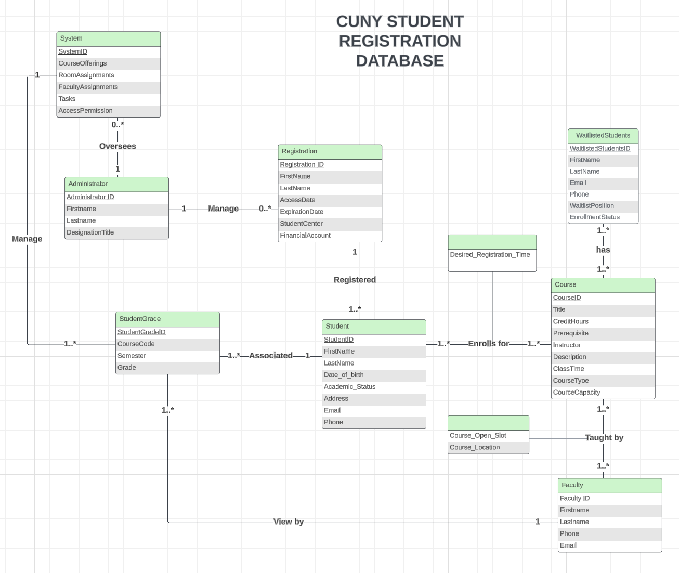
Entity Relationship Model (ER-Diagram)

Slide 8
List of entities and attributes in the er-d model
Entities | Attributes
Student | StudentID, FirstName, LastName Date_of_birth, Email, Phone, Address, Academic_status
Course | CourseID, Title, Credit Hours, Prerequisite, Instructor, Description, Course_Type, ClassTime, Course_Capacity
Faculty | FacultyID, First_Name, Last_Name, Phone, Email
Administrators | AdministratorID, FirstName, LastName, DesignationTitle
Registration | Registration_ID, FirstName, LastName, AccessDate, ExpirationDate, StudentCenter, Financial Account
Student_Grade | Student_GradeID, Course Code, Semester, Grade
System | System_ID,CourseOfferings,RoomAssignments,FacultyAssignments,Tasks,AccessPermissions.
WaitlistedStudents | WaitlistedStudentsID,FirstName,LastName Email,Phone,WaitlistPosition,EnrollmentStatus

Slide 9
Logical Relationship
This is where we first introduced Foreign Keys!
Relation | Attributes
Student | Student ID, FirstName, LastName, Date_of_birth, Email, Phone, Address, Academic_status,RegistrationID(FK)
Course | CourseID, Title, Credit Hours, Prerequisite, Instructor, Description, Course_Type, ClassTime, Course_Capacity
Student_Course | Student_CourseID, StudentID(FK), CourseID(FK), Desired_Registration_Time
Faculty | FacultyID, First_Name, Last_Name, Phone, Email
Administrators | AdministratorID, FirstName, LastName, DesignationTitle
Faculty_Course | Faculty_CourseID,FacultyID(FK), CourseID(FK), Course_Open_Slot, Course_Location
Registration | Registration_ID, FirstName, LastName, AccessDate, ExpirationDate, StudentCenter, Financial Account, AdministratorID(fk)
Student_Grade | Student_GradeID, Course Code, Semester, Grade, Student_ID(fk), SystemID(FK), FacultyID(FK)
System | System_ID,CourseOfferings, RoomAssignments, FacultyAssignments,Tasks, AccessPermission, AdministratorID(fk)
WaitlistedStudents_Course | WaitlistedStudents_CourseID,WaitlistedStudentsID(fk),CourseID(fk)
WaitlistedStudents | WaitlistedStudentsID, FirstName, LastName, Email, Phone, WaitlistPosition, EnrollmentStatus

Slide 10
Normalization
What is Normalization?
Normalization involves several steps to organize data efficiently within a relational database:
First Normal Form (1NF): Ensuring atomicity by making sure each column contains only atomic values, meaning no repeating groups or arrays.
Second Normal Form (2NF): Eliminating partial dependencies by ensuring that every non-key attribute is fully dependent on the primary key.
Third Normal Form (3NF): Removing transitive dependencies by ensuring that every non-key attribute is dependent only on the primary key and not on other non-key attributes.

Slide 11
Assumptions about normalization exercise:
All tables not included were considered normalized after our first iteration
Intended to demonstrate how we worked through this process
Conceptualization necessitated expansion of attributes during this process
Student | StudentID, FirstName, LastName, Date_of_birth, Email, Phone, Address, Academic_status CourseID, Title, Credit Hours, Prerequisite, Instructor, Description, Course_Type, ClassTime, Course_Capacity, Course_Open_Slot Course_Location, FacultyID, FirstName, LastName Phone, Email

Slide 12

Functional dependencies
StudentID | FirstName | LastName | Date_of_Birth | Email | Phone | Address | Academic_ Status | Course ID | Title | Credit | Prerequisites | Instructor | Description | Course_ Type | Course_ Capacity | Course_Open_Slot | Course_ Location
FD3
FD 1
FD2
LIST OF ALL FUNCTIONAL DEPENDENCIES
Keys: StudentID, CourseID
FD1: Student ID,, -> FirstName,LastName,DateofBirth,Email,Phone,Address
FD2: CourseID -> Title,Credit,Prerequisite,Instructor,Description
FD3: CourseID -> CourseType,CourseCapacity,CourseOpenSlot,CourseLocation

Slide 13
Normalization process
1NF:
Student_Enrollment (StudentID, FirstName, LastName, Date_of_birth, Email, Phone, Address, Academic_status, CourseID, Title, Credit, Prerequisite, Instructor, Description, Course_Type, ClassTime, Course_Capacity, Course_Open_Slot, Course_Location)
2NF:
Student_Enrollment (StudentID, CourseID, Course_Open_Slot, Course_Location)
Student(StudentID, FirstName, LastName, Date_of_birth, Email, Phone, Address, Academic_Status)
Course(CourseID, Title, Credit, Prerequisite, Instructor, Description, Course_Type, ClassTime, Course_Capacity)
3NF:
Student_Enrollment (StudentID, CourseID)
Student(StudentID, FirstName, LastName, Date_of_birth, Email, Phone, Address)
Course(CourseID, Title, Credit, Prerequisite, Instructor, Description, ClassTime)
Course_Description(CourseID (FK), Course_Open_Slot, Course_Location, Course_Type, Course_Capacity)
Student_Record(StudentID (FK), Academic_Status)

Slide 14
Creating the Database Schema with Structured Query Language
Here are few examples of codes we used to create tables!
2) CREATE TABLE Course (
CourseID VARCHAR(10) PRIMARY KEY,
Title VARCHAR(55),
CreditHours INT,
Prerequisite VARCHAR(55),
Instructor VARCHAR(55),
Description TEXT,
Course_Type VARCHAR(55),
ClassTime VARCHAR(55),
Course_Capacity INT);
1) CREATE TABLE Student (
StudentID INT PRIMARY KEY,
FirstName VARCHAR(55),
LastName VARCHAR(55),
Date_of_birth DATE,
Email VARCHAR(55),
Phone VARCHAR(55),
Address TEXT,
Academic_status VARCHAR(55),
RegistrationID INT);
3) CREATE TABLE Faculty (
FacultyID INT PRIMARY KEY,
First_Name VARCHAR(55),
Last_Name VARCHAR(55),
Phone VARCHAR(55),
Email VARCHAR(55));
4) CREATE TABLE Administrators (
AdministratorID INT PRIMARY KEY,
FirstName VARCHAR(55),
LastName VARCHAR(55),
DesignationTitle VARCHAR(55));
5) CREATE TABLE Registration (
Registration_ID INT PRIMARY KEY,
FirstName VARCHAR(55),
LastName VARCHAR(55),
AccessDate DATE,
ExpirationDate DATE,
StudentCenter VARCHAR(55),
FinancialAccount VARCHAR(55),
AdministratorID INT);

Slide 15
Adding foreign keys
We decided to add foreign keys to link the tables together. Below are few examples:
1) ALTER TABLE Student
ADD CONSTRAINT FK_Student_Registration
FOREIGN KEY (RegistrationID) REFERENCES Registration(Registration_ID);
2) ALTER TABLE Student_Course
ADD CONSTRAINT FK_Student_Course_Student
FOREIGN KEY (StudentID) REFERENCES Student(StudentID);
3) ALTER TABLE Student_Course
ADD CONSTRAINT FK_Student_Course_Course
FOREIGN KEY (CourseID) REFERENCES Course(CourseID);
4) ALTER TABLE Faculty_Course
ADD CONSTRAINT FK_Faculty_Course_Faculty
FOREIGN KEY (FacultyID) REFERENCES Faculty(FacultyID);

Slide 16
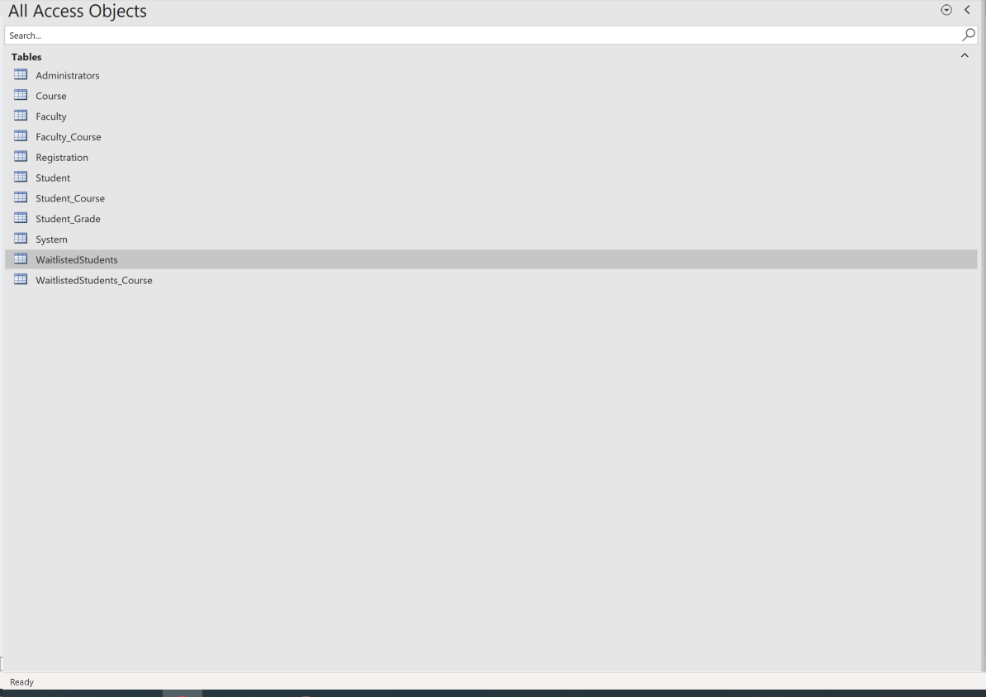
DATABASE SCHEMA

Slide 17
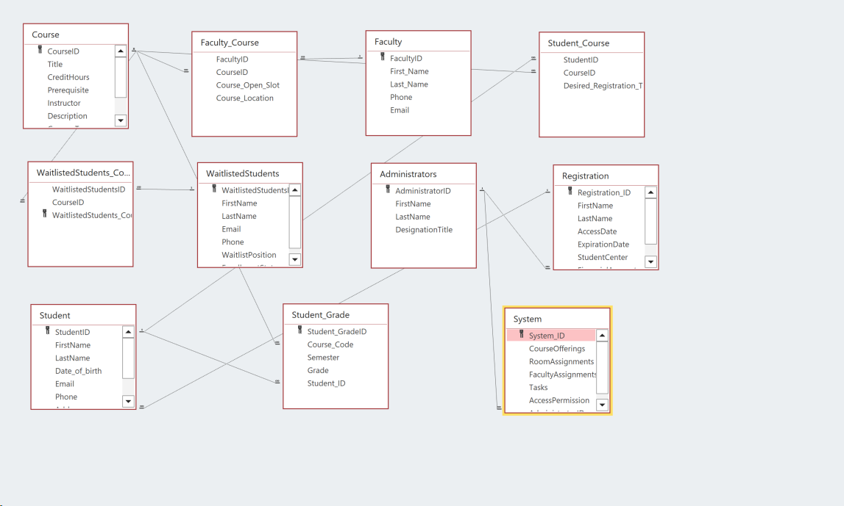
RELATIONSHIP VIEW

Slide 18
Thank you

